Slide 1

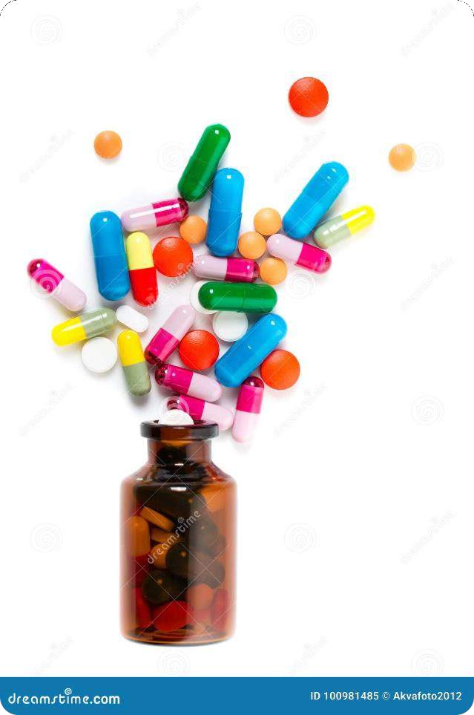
Counterfeit
Pharmaceuticals: A Global Threat
Counterfeit pharmaceuticals are a growing problem worldwide, posing significant health risks and economic losses. These fake medications can contain harmful ingredients, leading to adverse health effects or even death. In many cases, the origin of counterfeit drugs is difficult to trace, creating vulnerabilities in traditional supply chains.

Slide 2
Challenges of Traditional Supply Chains
Lack of Transparency
Data Security
Limited Traceability
Traditional supply chains often lack transparency, making it difficult to track the journey of pharmaceuticals from manufacturers to consumers.
This creates opportunities for
counterfeiters to insert fake products into the supply chain.
Data related to pharmaceutical transactions is often stored in multiple, disconnected systems, making it vulnerable to manipulation and breaches. This This can result in inaccurate records and compromised product authenticity.
Traditional systems often lack a comprehensive and real-time view of the supply chain, making making it challenging to identify identify counterfeit products and and trace them back to their origin.

Slide 3

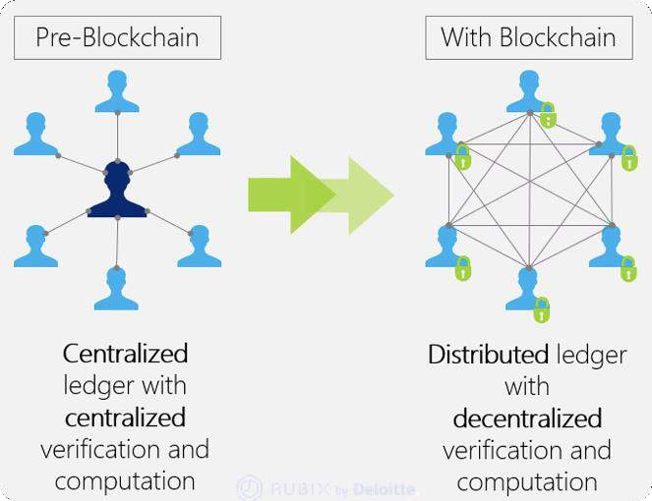
Blockchain: A Secure Solution
1
Decentralized Database
Blockchain creates a decentralized and immutable record of all transactions, making it virtually impossible to alter or tamper with data.
2
Transparency and Traceability
Every transaction is recorded on the blockchain, providing complete transparency and
enabling real-time tracking of pharmaceutical products from origin to destination.
3
Enhanced Security
The decentralized nature of blockchain makes it highly resistant to hacking and manipulation, manipulation, ensuring the integrity of data and the authenticity of pharmaceuticals.
4
Improved Trust
Blockchain fosters trust among all participants in the supply chain, including manufacturers, manufacturers, distributors, and consumers, by providing a secure and transparent platform platform for tracking products.

Slide 4

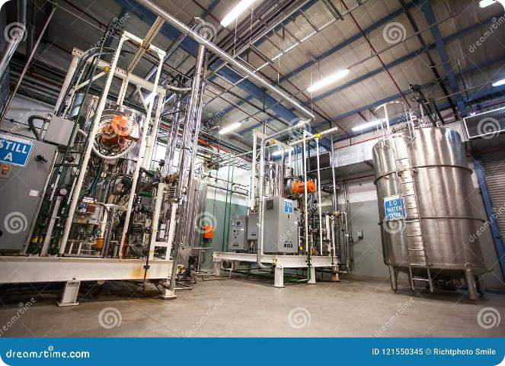
Tracking Pharmaceutical Transactions
1
Manufacturing
Pharmaceutical manufacturers can record the production details and batch numbers numbers of medications on the blockchain.
2
Distribution
Distributors can track the movement of medications from manufacturers to wholesalers and retailers, recording each transaction on the blockchain.
3
Retail
Retailers can use blockchain to verify the authenticity of pharmaceuticals and ensure ensure they are not counterfeit before dispensing them to patients.
4
Consumer
Consumers can access information about the origin and journey of their medications medications through a mobile app or website linked to the blockchain.

Slide 5


Ensuring Authenticity and Transparency
Product Authentication
Blockchain enables the creation of unique digital signatures for each pharmaceutical product, ensuring its ensuring its authenticity and traceability.
Transparency for Stakeholders
All stakeholders, including manufacturers, distributors, regulators, and consumers, can access and verify information about the origin, journey, and authenticity of pharmaceuticals through the blockchain.
Real-Time Monitoring
Blockchain provides real-time visibility into the supply chain, allowing stakeholders to monitor the movement of pharmaceuticals and identify potential issues or counterfeit products.

Slide 6


Reducing Health Risks and Economic Economic Losses
Improved Patient Safety
By eliminating counterfeit pharmaceuticals, blockchain helps ensure patients receive receive safe and effective medications, reducing the risk of adverse health effects.
Reduced Economic Losses
Counterfeit pharmaceuticals result in significant financial losses for manufacturers, distributors, and consumers. Blockchain helps combat counterfeit products, minimizing minimizing economic damage.
Stronger Supply Chains
Blockchain creates a more secure and robust supply chain, making it harder for counterfeiters to operate and improving the overall integrity of the pharmaceutical industry.

Slide 7


Implementing a Blockchain-Based System System
1. **Define Scope and Objectives**: Clearly define the scope of the blockchain system and the the key objectives it aims to achieve.
2. **Choose a Blockchain Platform**: Select a suitable blockchain platform that meets the specific requirements of the pharmaceutical supply chain.
3. **Develop Smart Contracts**: Design and implement smart contracts to automate key processes and transactions on the blockchain.
4. **Integrate with Existing Systems**: Integrate the blockchain system with existing systems systems and databases to ensure seamless data flow.
5. **Pilot Testing and Deployment**: Conduct pilot testing to validate the system's functionality and performance before full-scale deployment.
6. **Training and Support**: Provide training to stakeholders on how to use and interact with the with the blockchain system.
7. **Continuous Monitoring and Improvement**: Regularly monitor the system's performance and identify areas for improvement and optimization.

Slide 8
Created By — Code Rushers
Snehal Vattikonda
Znana Sai Kolli
Harsha Vardhan Vempadapu

